Slide 1
Music Learning Experience
Adam Tait, taitah@mail.uc.edu
Eric Gatto, gattoej@mail.uc.edu
Jason Judas, judisjt@mail.uc.edu
John Rose, rose2j4@mail.uc.edu
Advisor:
Prof. Carla Purdy, purdycc@ucmail.uc.edu

Slide 2
Goals
We will create a device and application that can easily teach kids about music. This will include the production of an electronic piano-like device using a Microchip board and a 3-D printed body. The devices body will be designed for kids, a smaller form factor, hard to break, and colorful. Our software is going to be built to be robust yet simple so kids can pick it up and learn with little outside intervention. Our hope is to teach kids about music theory and creation in a fun and educational environment.

Slide 3
Intellectual Merits
3D printing allows us to prototype and make design changes with ease.
A modular and powerful PIC board allows extra functionality to be added with very little overhead.
Hardware and software designed for children to write music.

Slide 4

Broader Impacts
Our project will allow children to be introduced to music through a fun and engaging digital environment.
Children who learn music have the tendency to perform better academically.

Slide 5
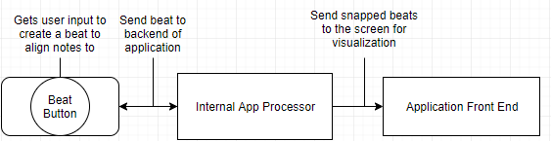
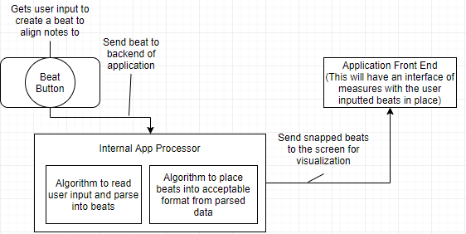
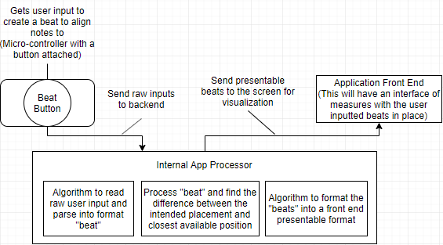
Design Specifications

Slide 6
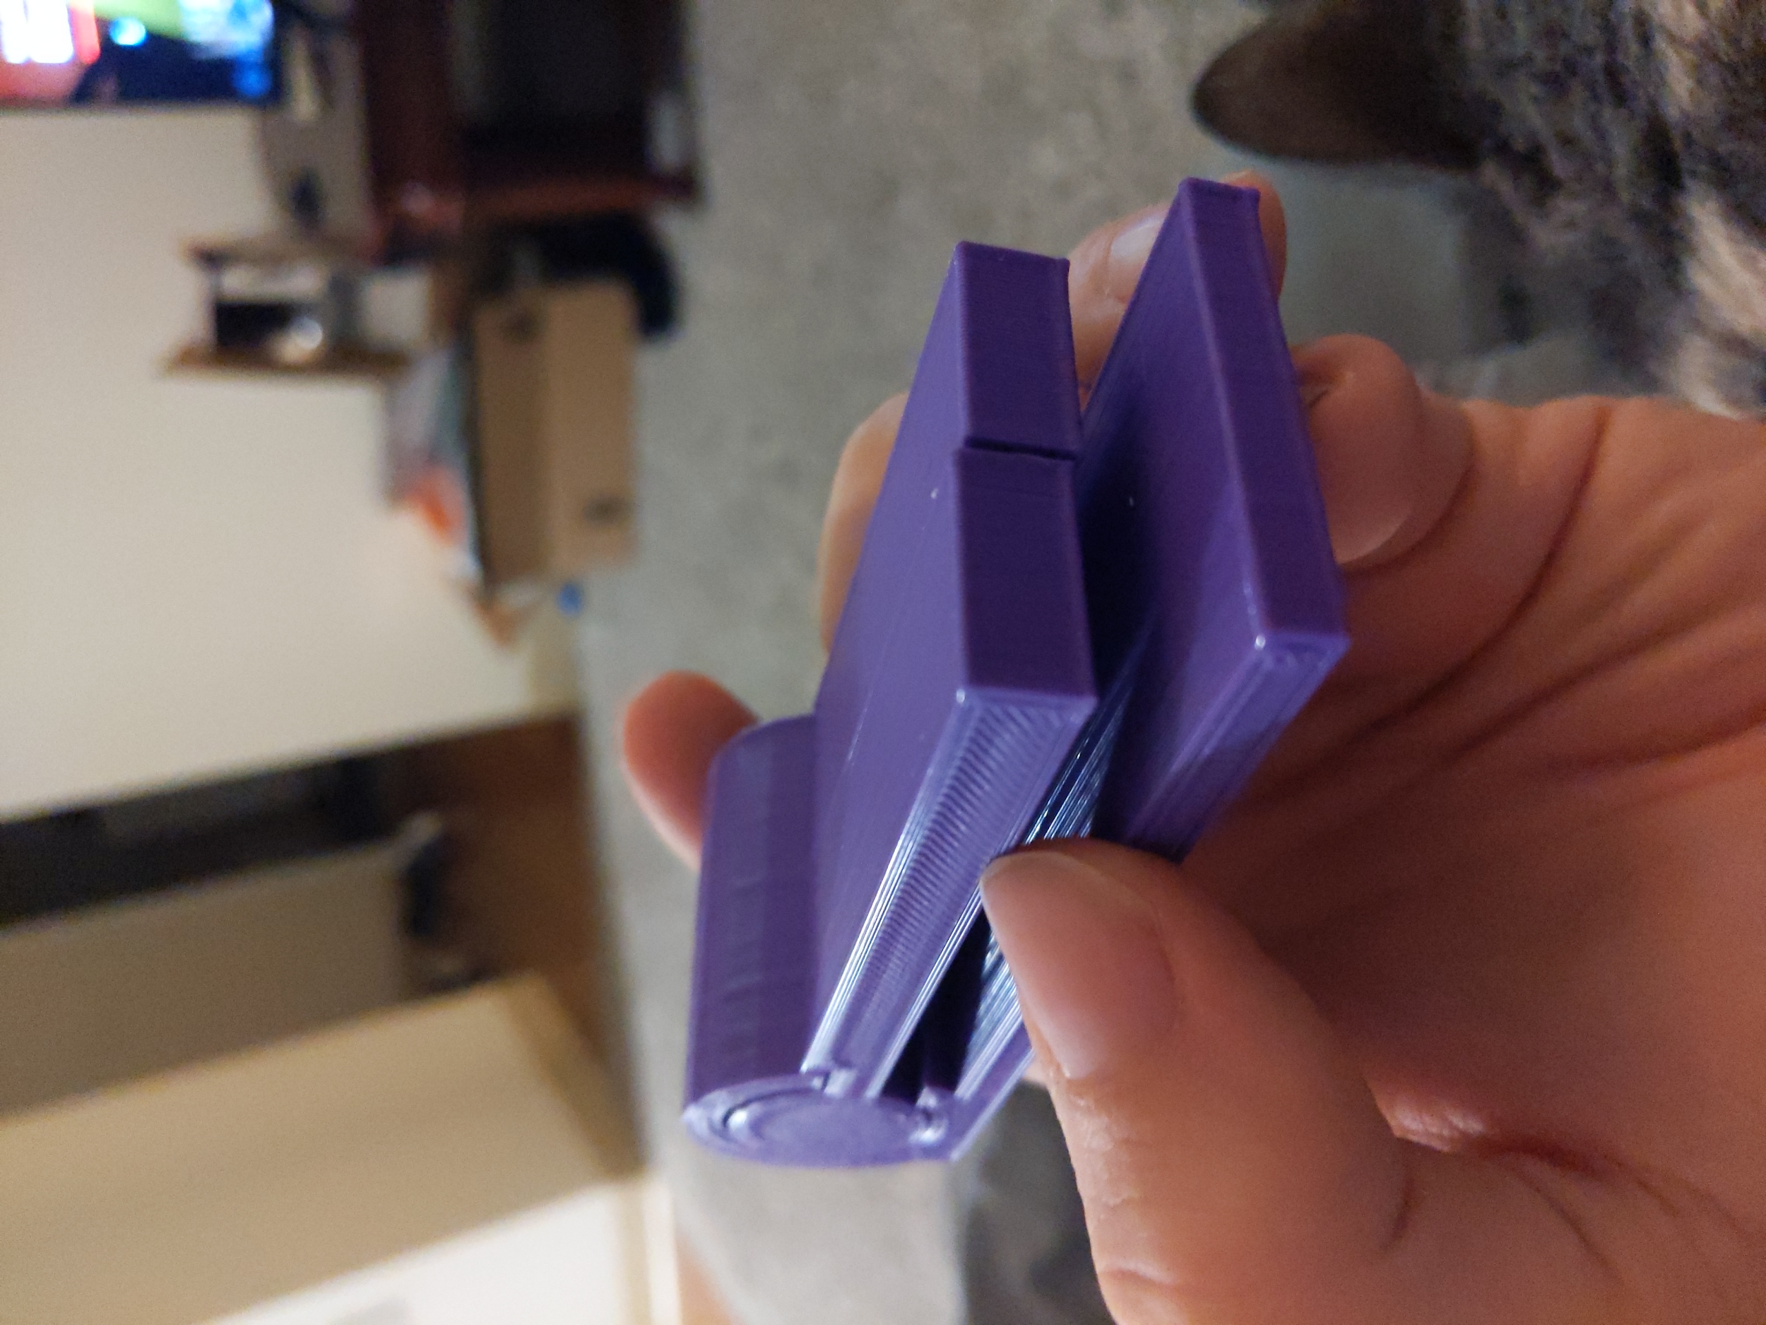
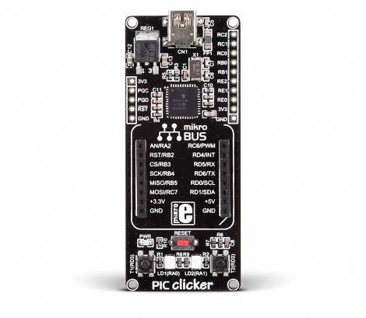
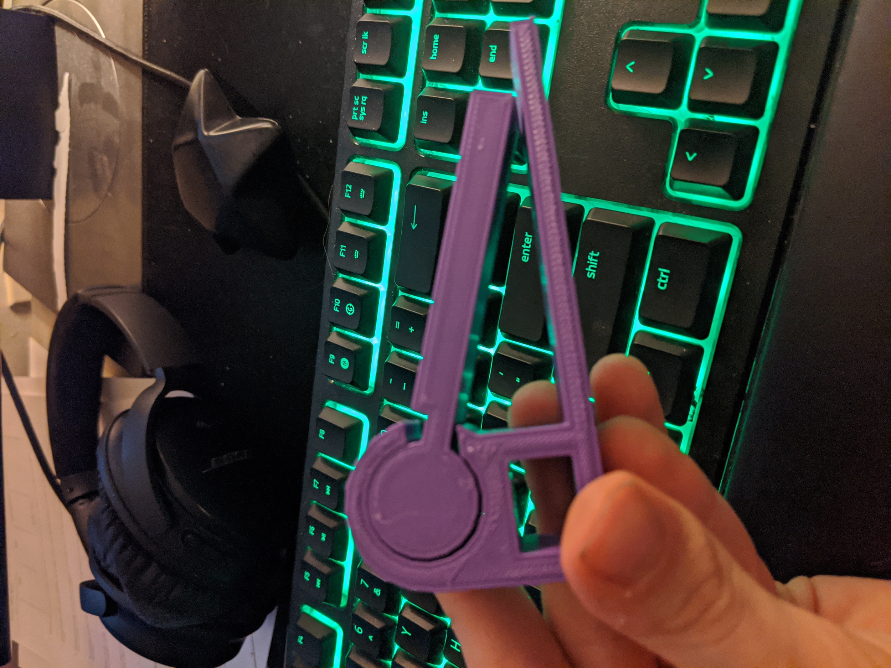
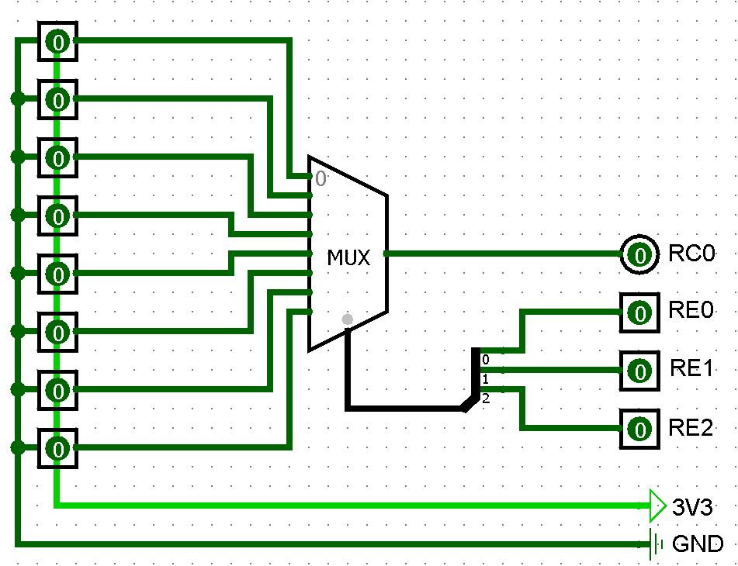
Design Specifications
Prototype #1:
Clicker Board:
Circuit Diagram:
Prototype #2:

Slide 7


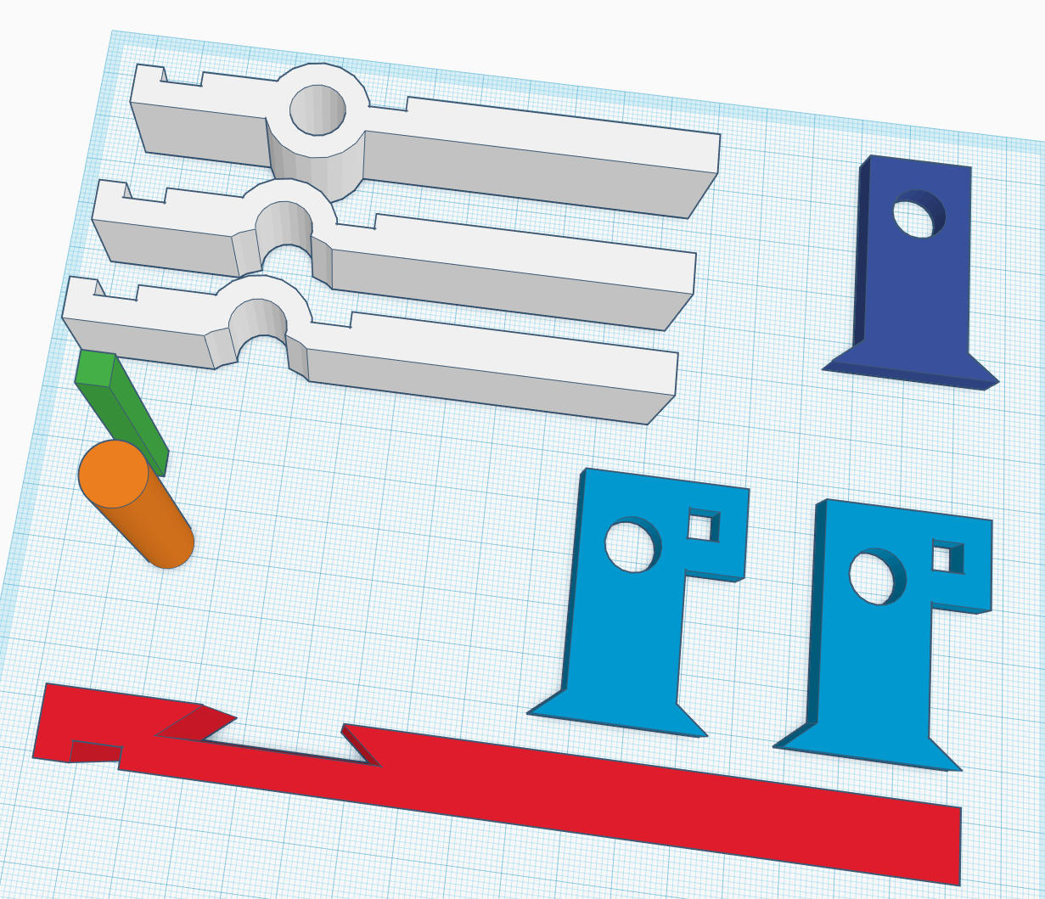

Technologies
3D printing
Model designed in AUTODESK TINKERCAD
Creality CR-10
Prototype - PLA filament
Final Design - ABS filament
A PIC18 Clicker board programmed to transmit packets over USB dependent on the user’s input.
A custom USB packet
Unity/C#

Slide 8
Milestones
Create UI Elements (Staff, notes, treble clef, buttons, etc.) (Jan. 17)
Design keyboard circuit (Jan. 22)
Design and print keyboard keys (Feb. 9)
Design UI and menus (Feb. 14)
Create music system (Feb. 21)
Print and build keyboard enclosure (Mar. 6)
Initial serial communication (Mar. 6)
Enable note placement on staff (Mar. 13)
Message passing through serial communication (Apr. 3)
Create Saving/Loading of song (Apr. 3)

Slide 9
Results
Completed
Designs and technology decisions are almost all made
3 prototypes of the piano design have been created
The main menu design has been designed and coded
The circuit design has been completed
To be Completed
Decide on and cleanup the final piano design
Finish the scrolling and note placement within the software
Put together the piano body with the actual hardware
Test the final product and clean up the final product

Slide 10
Challenges
We have to calculate how fast to scroll the screen based on the beats per minute. This has caused a bit of a roadblock that has yet to be resolved.
Button Debouncing
Printing our housing for the piano has caused us a few problems such as how to add a spring back action to the keys, how to design the piano optimally for 3D printing, and just dealing with the 3D printer in general. The spring back problem is still in the works and we are thinking of using rubber bands. The optimal design just took some different designing techniques to work around. The printer in general was solved by just taking the time to calibrate and flipping the bed surface.

